Slide 1
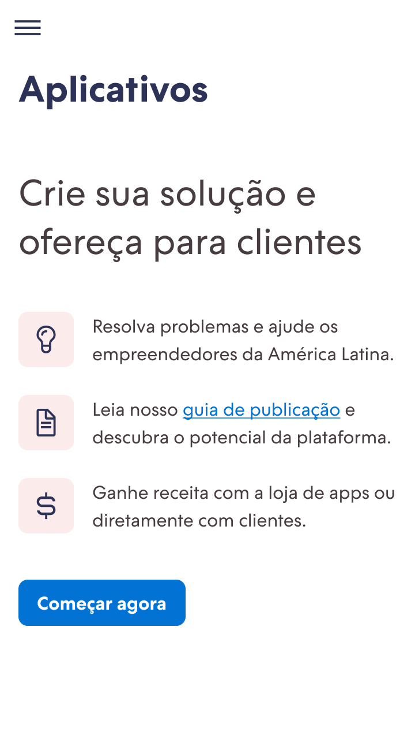
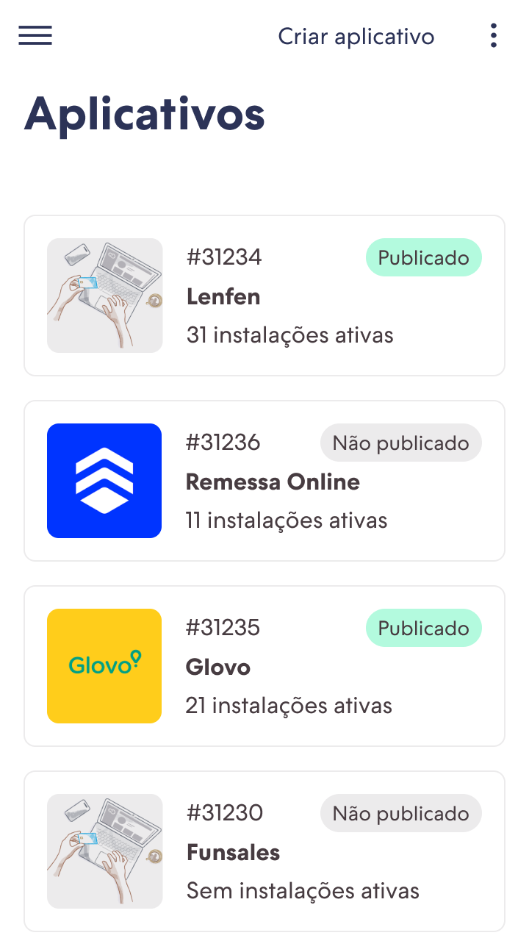

Redesign of Admin for Partners
2021

Slide 2
Context
Today I work together with the product and engineering teams in the Ecosystem business unit. This BU is responsible for digital products focused on partners who connect to our platform and offer products or services to our customers. There is a wide diversity of partners, ranging from software houses to affiliates.
One of the partners' main tools is the administrator, which is where they manage the partnership with us. It is through this tool that partners can, among other activities, withdraw their commissions, publish a new application in our appstore and follow the list of e-commerce sites created with their indication.
Highlights
Ecosystem: business unit of the company
Admin for Partners is the main system
~6k of active users / month
The team of this unit is being built
4 designers , 3 front-end devs, 4 back-end devs

Slide 3
Context
2
2
Today I lead a team of 4 product designers, all allocated within the Ecosystem tribe. The Design System and Admin for Partners squads have focused designers. The other squads receive a specific dedication according to demand.
This case is related to the Admin for Partners squad, which has led the migration from the old administrator to a completely new one. Within this context, I have also worked in the execution because the demand was very high.
Design System
Admin for Partners
Channels of Sales
App Discoverability

Slide 4
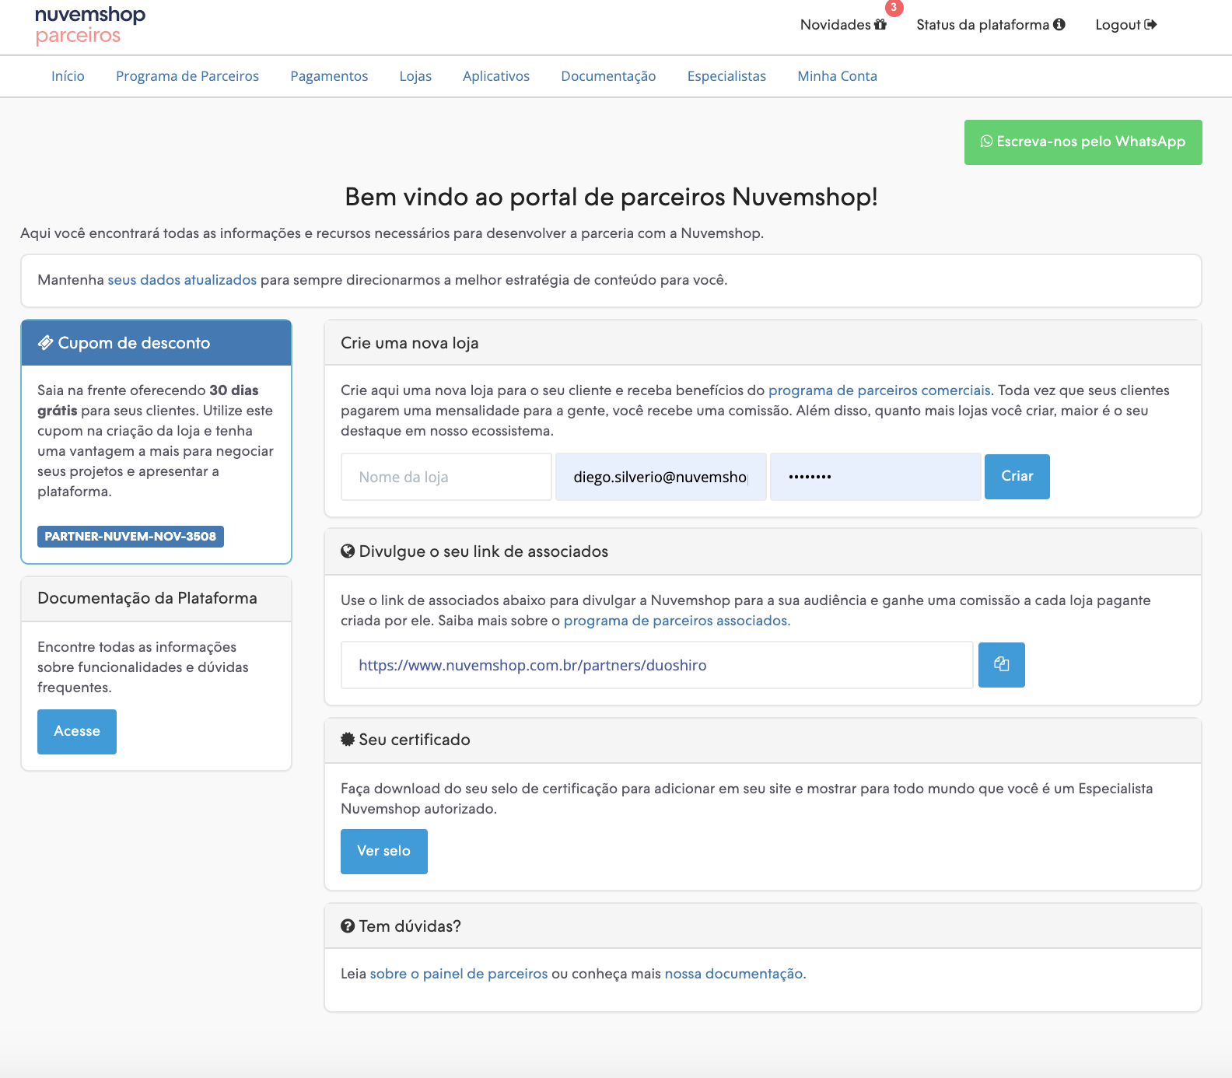
Challenge
The legacy system is too old, merged to the core and restrict further improvements.
As we can see in the image on the right, our current administrator is old and also coupled to the backend of the Nuvemhsop core platform. This means that our tool has many dependencies (such as authentication) and consequently many barriers for us to deliver more value for our partners.

Slide 5
Decision point
We have many complaints from partners
Unmerge from the core to gain speed
Enable future improvements to be easier and quicker to implement
We knew through some partners and our operation that the administrator had many problems that impacted the routine of partners and generated many complaints.
The Admin for Partners was built inside the Nuvemshop core. This made it have a lot of dependencies on the core and therefore a lot of barriers when it came to doing maintenance or implementing improvements.
We wanted to quickly deliver a big number of improvements for our partners. To make this possible, we needed to migrate the administrator to a new technology.

Slide 6
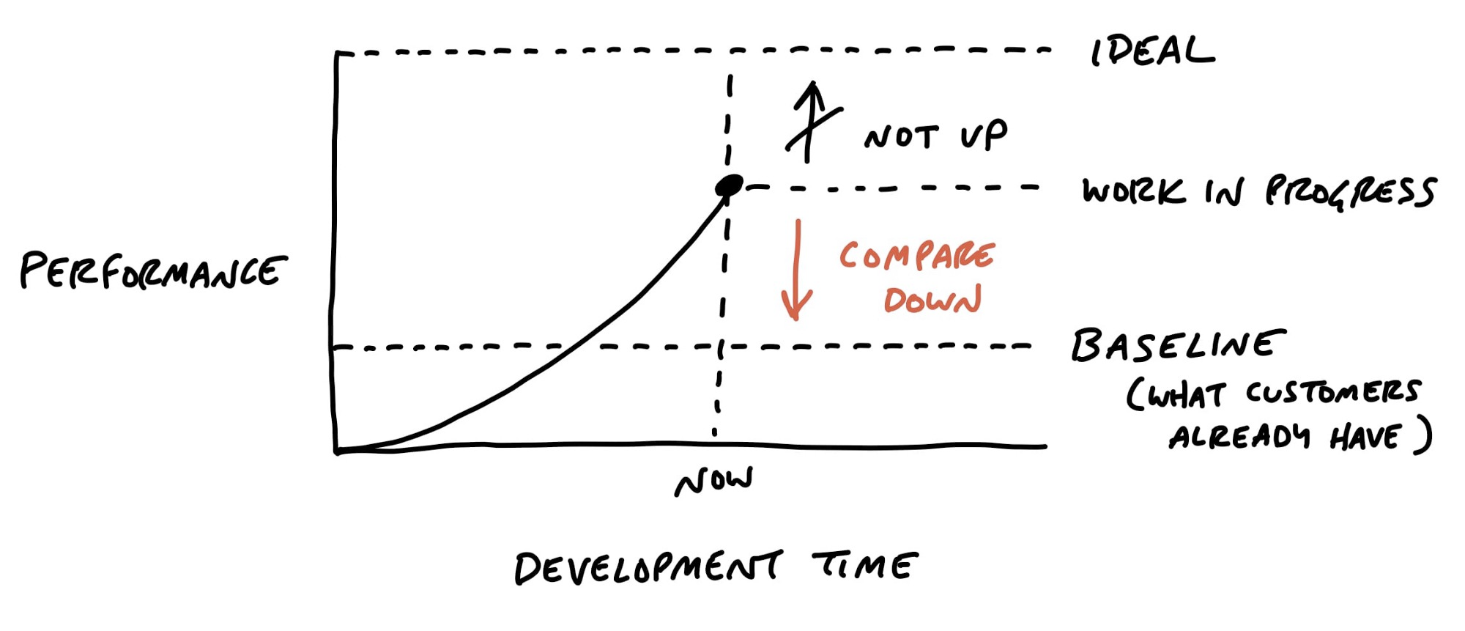
Decision point
How can we move fast on this migration?
As there are many opportunities for improvement, we ran the risk of adding too many modifications and extending the migration too much. Therefore, we took the decision to add a few improvements that had high impact, such as being mobile friendly, and trying to get closer to the baseline, so we would gain speed to finish this transition.

Slide 7
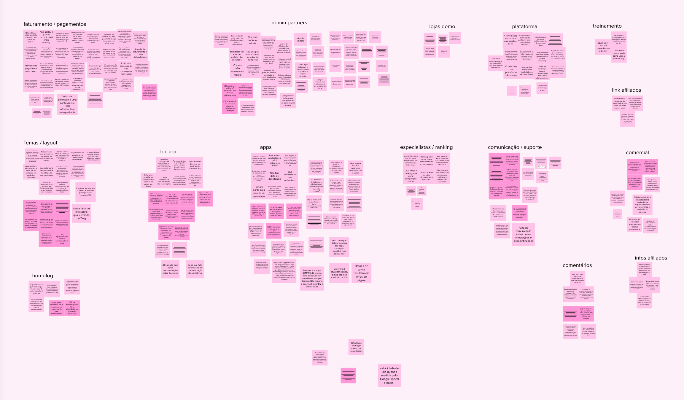
Decision point
Along with tech migration, what real value could we add for users?
Together with the technology migration, we wanted to bring real value to our partners in this case. We did a qualitative research with about 30 partners of different types, and found a wide range of problems. Our biggest challenge here was to prioritise these problems so that we could fit them into the migration. Some of the main problems were related to the use of the administrator, for example he had a very bad experience on mobile.

Slide 8
Decision point
Problems vs. Baseline
low hanging fruits
Responsive experience, mobile friendly
Better overview of the receivable balance
Reports of activities as partners
Better detailing of receivable balances
Filters in the stores listing
Steps in the creation of apps
Better access to docs for developers
Centralised communication about platform improvements
(...)

Slide 9
Project goals
1.
Redesign the system with little but impactful changes from baseline
2.
To use the new design system as base of this redesign
3.
Apply low-hanging fruit to add real value for partners

Slide 10






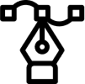
Process
Inputs from business
Decision
Research
Creative sessions
Design
We started this process together with product and engineering, considering the contributions we had from the business area, taking decisions together with them and the research we carried out with partners. After these steps, we entered in a continuous cycle inside the tribe, to advance in the Admin for Partners flows and hand over to the engineering team.
Hand over to built
Prototype

Slide 11
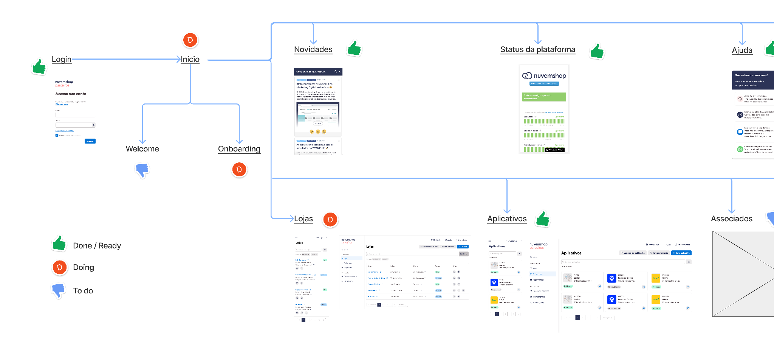
Process
To give visibility into all the flows we needed to migrate and also the status of their migration, I created a plan where I did this tracking from the design discipline point of view and reported weekly to the whole tribe.
The design team also benefited from this tracking because they knew exactly who was responsible for each part. In this way they gained more autonomy over migration.

Slide 12
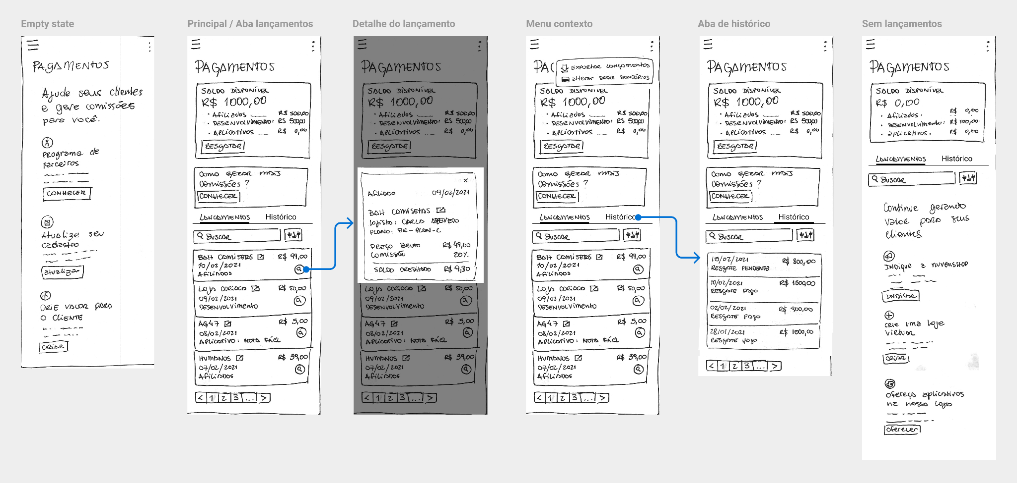
Execution

Slide 13
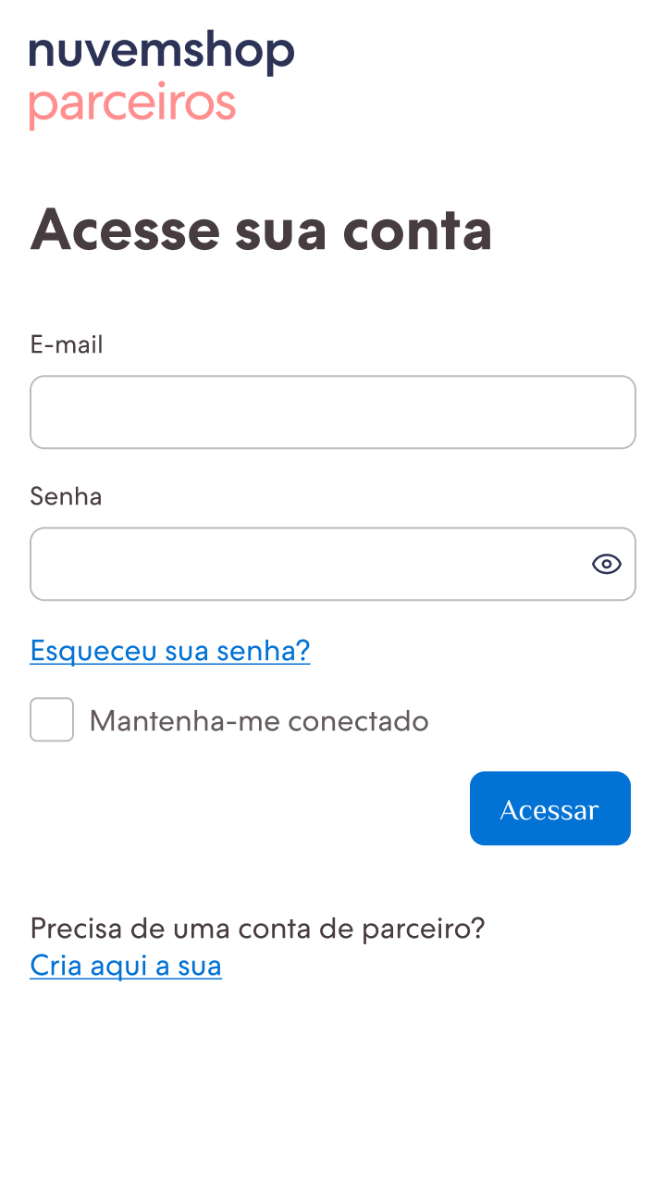
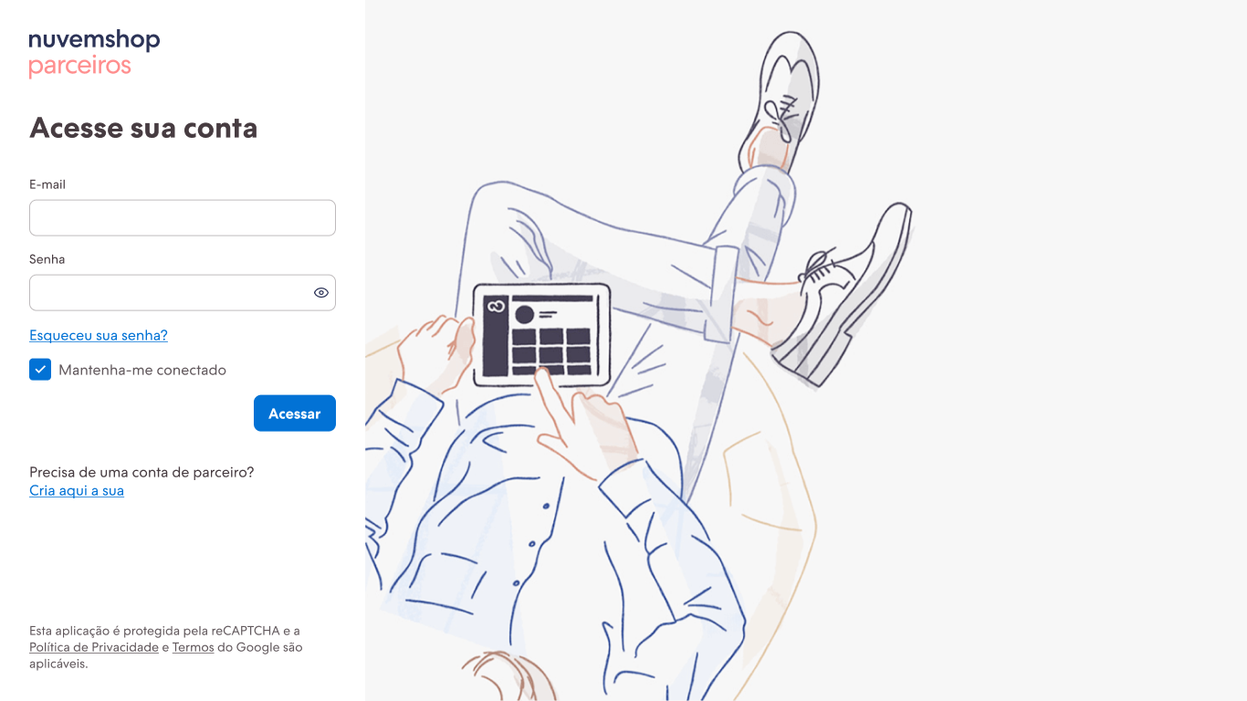
Execution
Login: mobile
Login: desktop

Slide 14
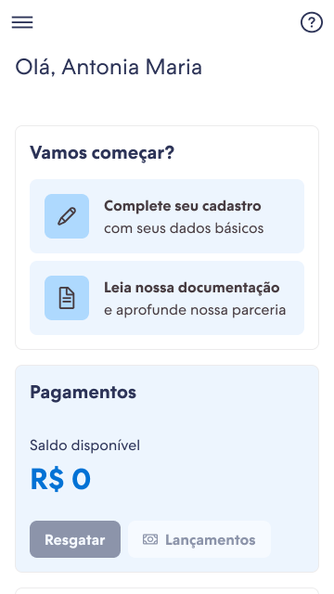
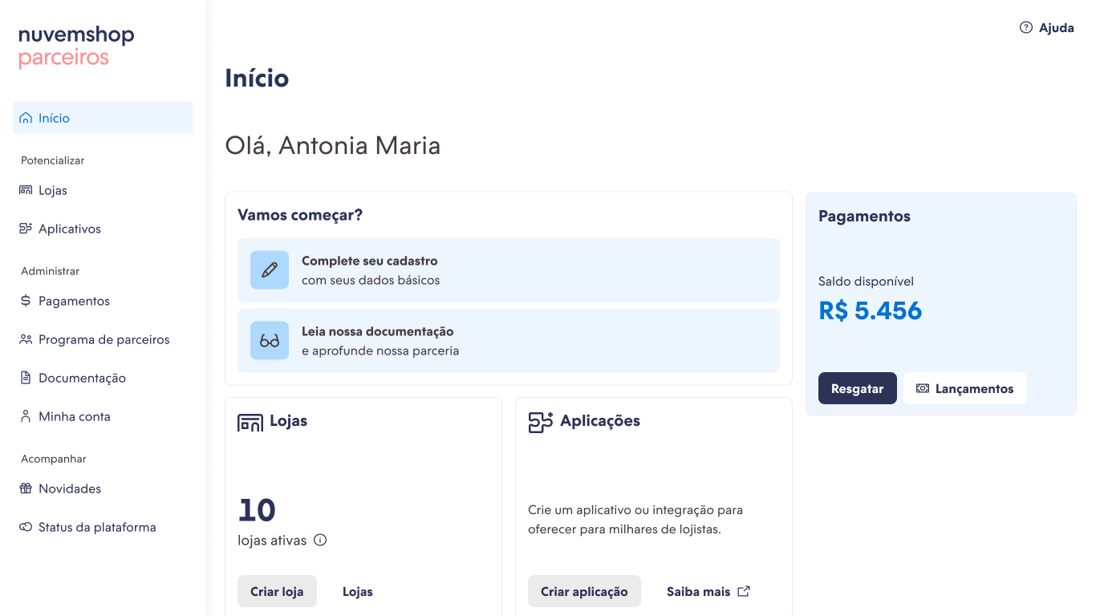
Execution
Home screen: mobile
Home screen: desktop

Slide 15
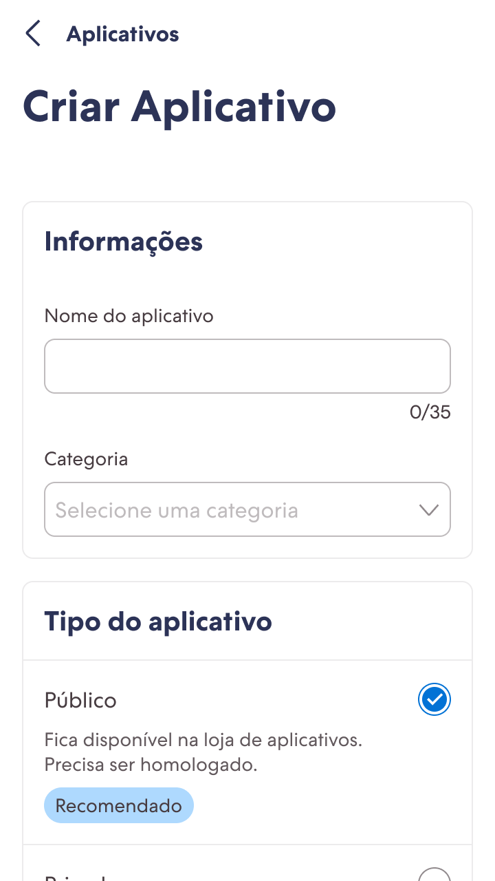
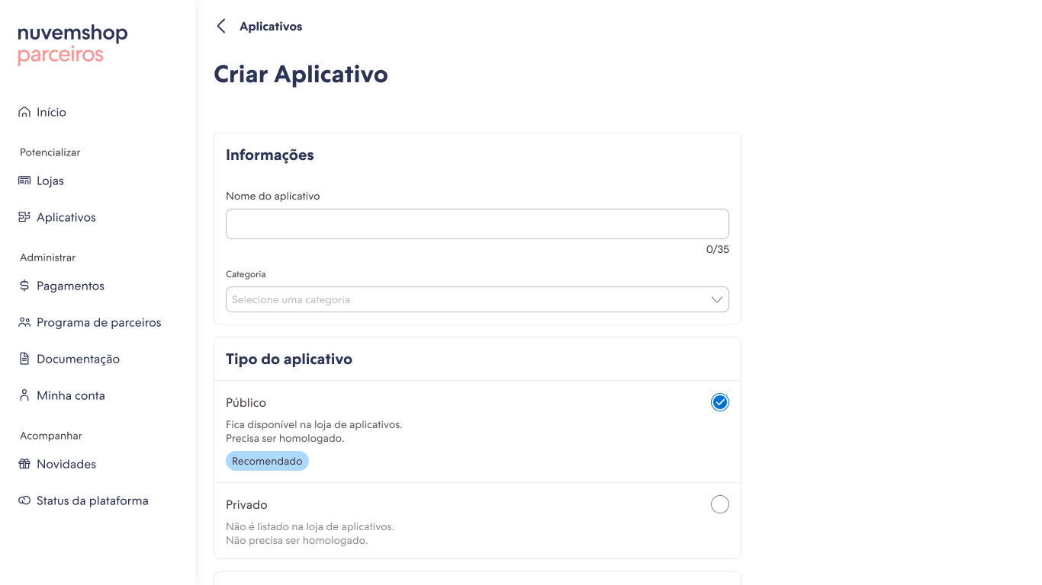
Execution
App create form: mobile
App create form: desktop

Slide 16
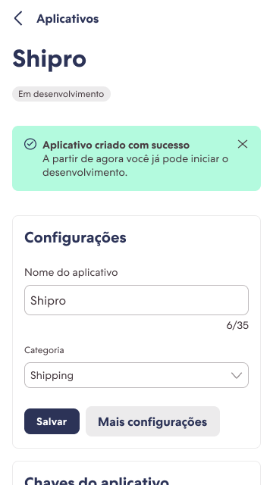
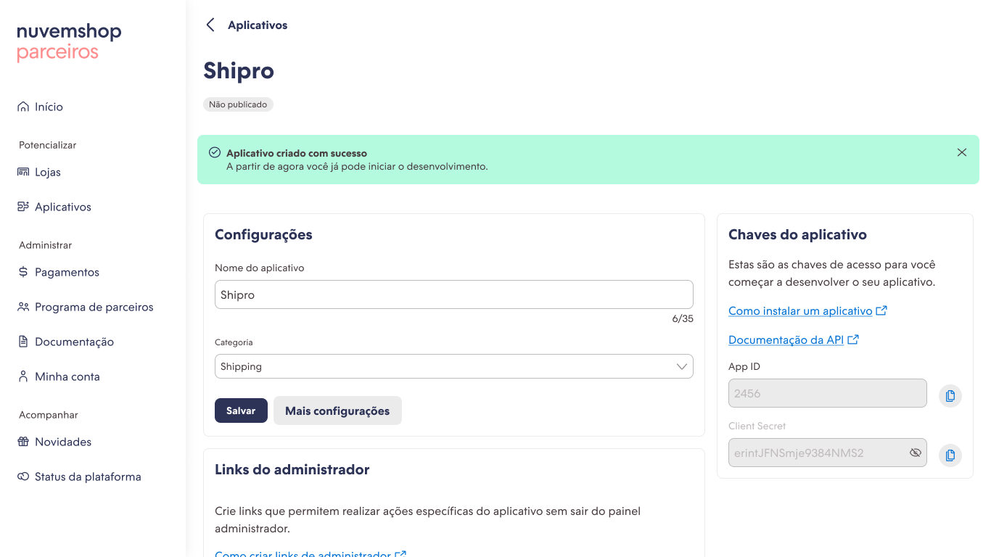
Execution
Apps details: mobile
Apps details: desktop

Slide 17
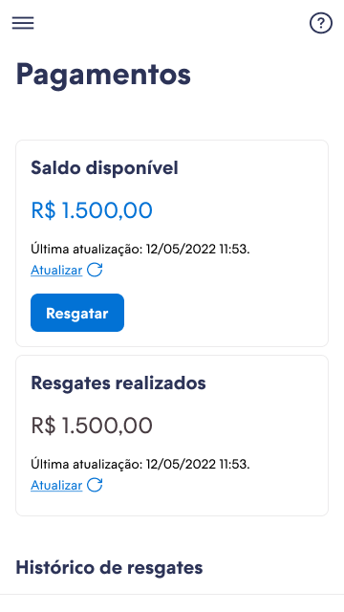
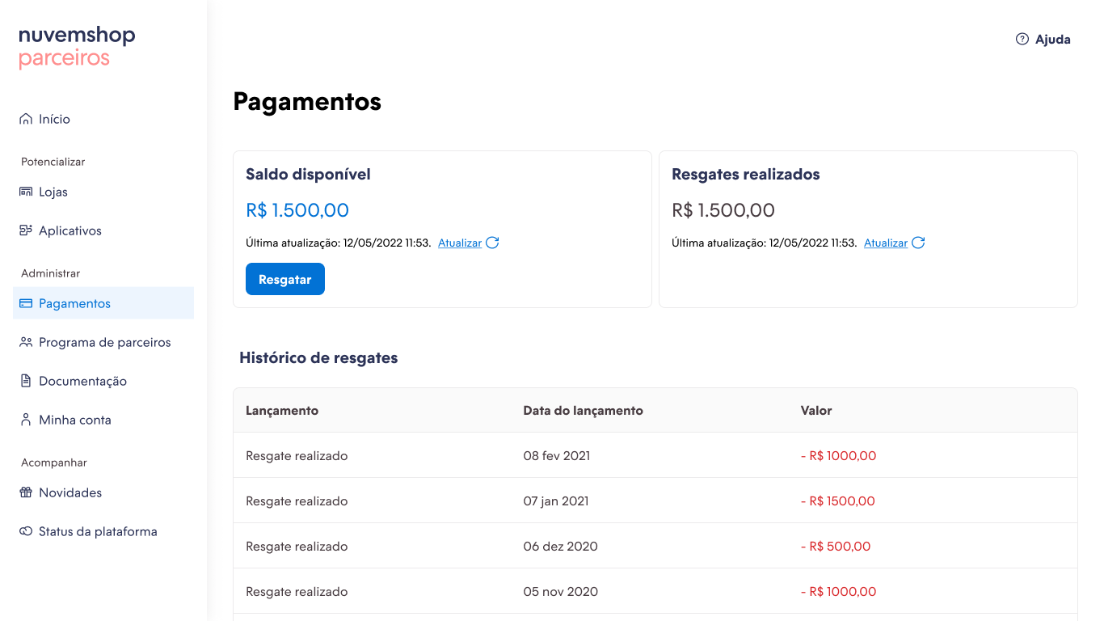
Execution
Balance details: mobile
Balance details: desktop

Slide 18
Execution
Original system
After redesign

Slide 19
Results
100% of migrated functionalities
100% partners using the new platform
4,5 satisfaction score of the new version
We migrated all the functionalities that existed in the old platform to the new one, making room for improvements and new features.
We completed the migration with the entire partner base using the new platform in 8 months, without the need to rollback users and maintain accounts on the old platform.
Our satisfaction goal was to be equal to or greater than satisfaction with the previous platform. At the end of the migration, we met our target and identified frictions in the experience of the new platform.

Slide 20
Learnings
What would I do differently?
Explored more MVPs during migration
Broken down deliveries into smaller parts
Explored more the use of the design system
In most of the migration, we spent a lot of effort to deliver features, we could have done faster deliveries to test some critical features with selected users.
To move faster and collect more feedbacks during the migration, we could have broken down the deliverables better, keeping the goal of the migration as a whole.
We used our design system during the migration, however in some cases we customized it to meet some specific UI cases. I believe we would have moved faster if we had used the DS better and left it to evolve parts of the UI in the post-migration.

Slide 21
Thanks!

